Slide 1
MIS 710 Process Innovation and Management
3. Data & Resource
Modeling
Modeling organizational resources
Modeling data
Exporting BPMN to XML in Signavio
Healthcare example
Structured and Unstructured Process Models
Processes, transactional databases and data
warehousing
This lecture is based on Chapters 3 and 6 of the text “Business Process Management” by Akhil Kumar
© E. A. Stohr, 2021

Slide 2
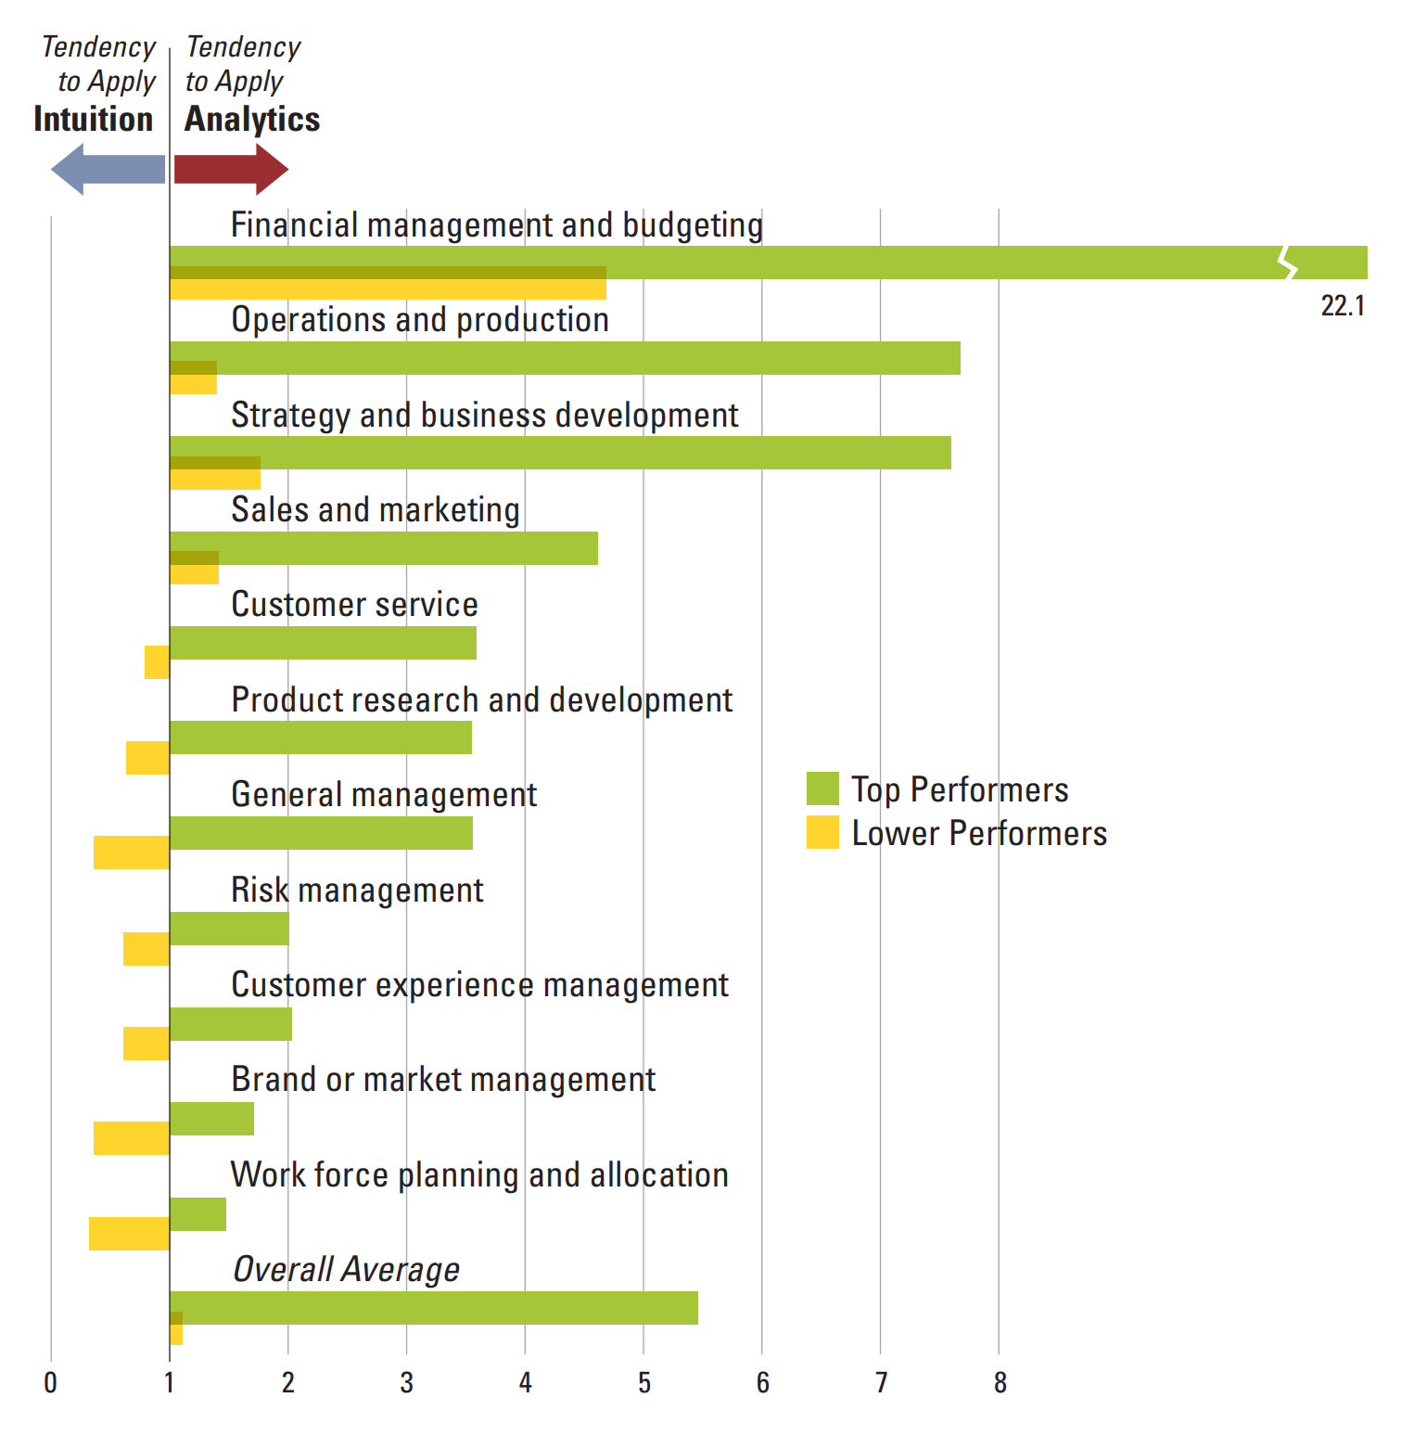
Analytics vs. Intuition
Evidence-base reasoning
Source: https://sloanreview.mit.edu/article/big-data-analytics-and-the-path-from-insights-to-value/

Slide 3
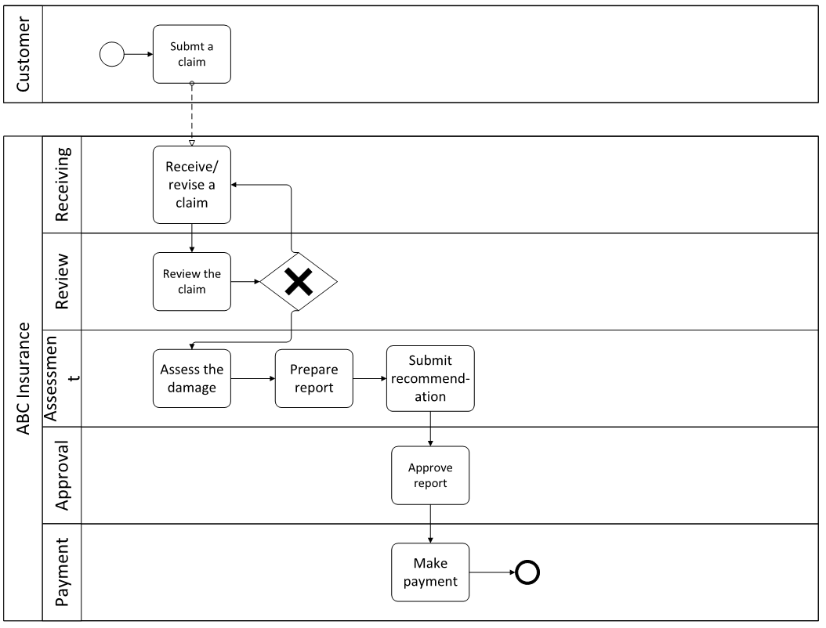
An insurance claim process on a swimlane diagram
Question: Which of the 5 perspectives are shown here?
AK: Figure 3.2

Slide 4
Swimlanes
Organizational Perspective:
Basically swimlanes enable someone looking at the model to see at a glance who performs what task
The customer and ABC Insurance are two separate entities and their internal processes are independent of one another
In general we assume that they are not interoperable, and the only way for the two processes to interact is through the exchange of messages.
The solid lines across lane boundaries indicating that the flows of control within a process are valid
A message is a generic term for passing of information across two parties

Slide 5
Representing data in BPMN diagrams
Research Notes
Research Notes
Research the topic
Write text
Research the topic
Write text
We use the notion of an association link to represent the input and output data of an activity
Output of the ‘Research the topic’ activity is a document data object called ‘Research Notes,’ and the same data object is the input of the ‘Write text’ activity
The control flow is the order in which the activities are performed (represented by solid lines) in the data flow
The two diagrams represent the same idea
AK: Figure 3.4

Slide 6
Modeling data
To process a claim we need some essential information from the customer like customer name, policy number, date of claim, details of claim, etc.
This information will be required at every step of this process
Two ways:
Capture the information at the start of the process at the receive claim task and then keep on passing it along to successive tasks
Capture this information at the receive claim task, assign a claim Id to it and then store it in the database of the company as a new claim which can then be accessed at every step (better).
Choice:
Assign the claim_Id only after the claim has been reviewed as there is no point in assigning an Id to a bogus claim
The system may still assign a claim Id to the rejected claim, mark it as rejected, and store it in the database (better).

Slide 7
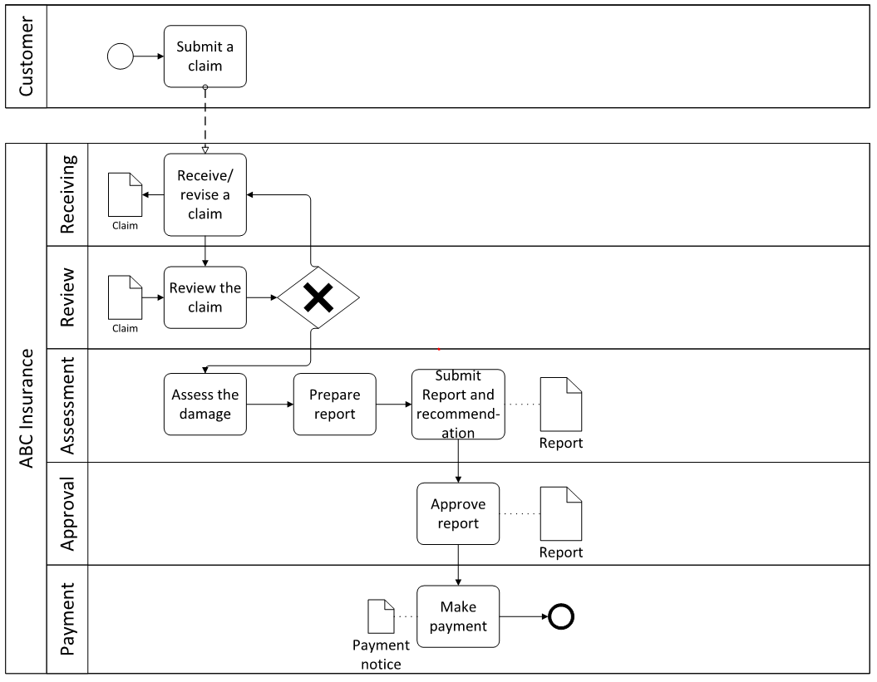
BPMN process model with data
AK: Figure 3.5
The symbol for a data object is a rectangle with a fold at the top right corner
Data objects are connected to the task that accesses them using a (dotted line) association link
If an activity writes to the data object then the link is directed outwards from the task to the object, while if it reads from it then the direction of the arrow is reversed.
Most BPMN modeling tools such as Signavio, Visio, etc. allow data objects.

Slide 8
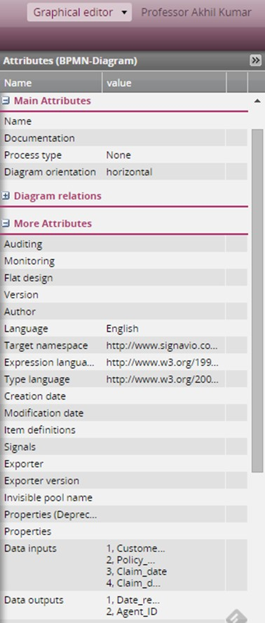
A screenshot of the attributes pane on the right margin of the Signavio modeler screen
BPMN process model with data
AK: Figure 3.6

Slide 9
Review claim screen
Customer Id: Customer Name:
Claim Id:
Coverage until:
Information complete? Yes No
Accept
claim
Reject
claim
DataObject Claim{
Customer name String[50];
Policy number String[40];
Claim Date Date;
Claim details String[250];
}
Note: Screens and reports have a data structure. Often, they represent data items from multiple tables in a relational database.
AK: Figure 3.3

Slide 10
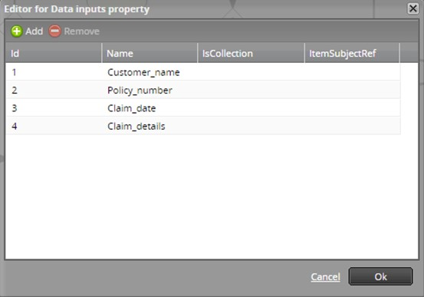
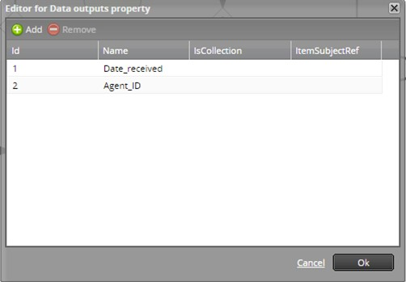
Input & Output Screens
A screenshot of the data inputs screen from Signavio
A screenshot of the data outputs screen from Signavio
AK: Figures 3.& & 3.8

Slide 11
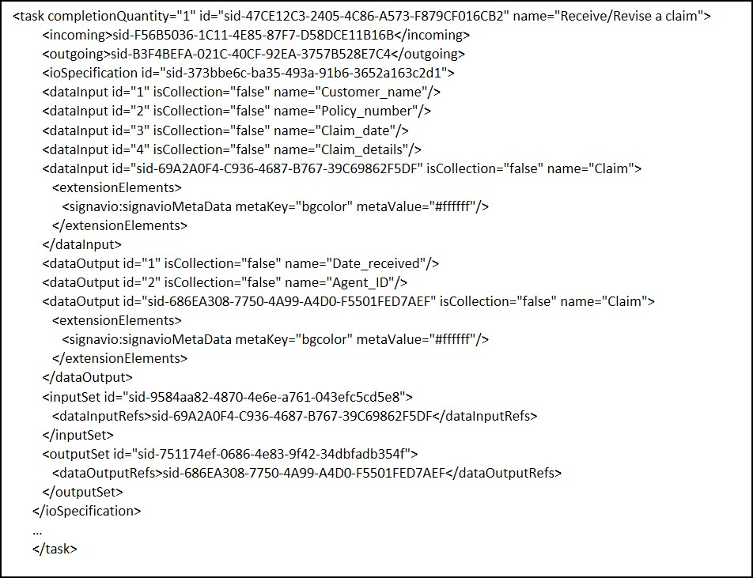
Exporting a BPMN diagram into an XML file
A BPMN model in the form of such drawings is useful for a visual understanding of the process
Valuable tool for one person to describe a process formally so that another person can understand it and check it
Any BPMN 2.0 file is stored as an XML file which is in “machine readable format”
AK: Figure 3.9

Slide 12
A Case Example from Healthcare: Eternal Health
The managers at Eternal-Health are trying to streamline their processes, and as a first step they wish to make process flow maps to help them understand their workflows and the interactions with their partners
In the diagram, pools (represented by rectangular blocks) correspond to workflow participants
A message flow (shown by dotted lines) is used to coordinate communication between two participants
Lanes are used to organize and categorize activities within a pool, say between a doctor and a nurse
The control flow among activities within a pool is shown by solid lines
Parallel gateways (shown in a diamond symbol with an asterisk) create parallel paths without checking any conditions.

Slide 13
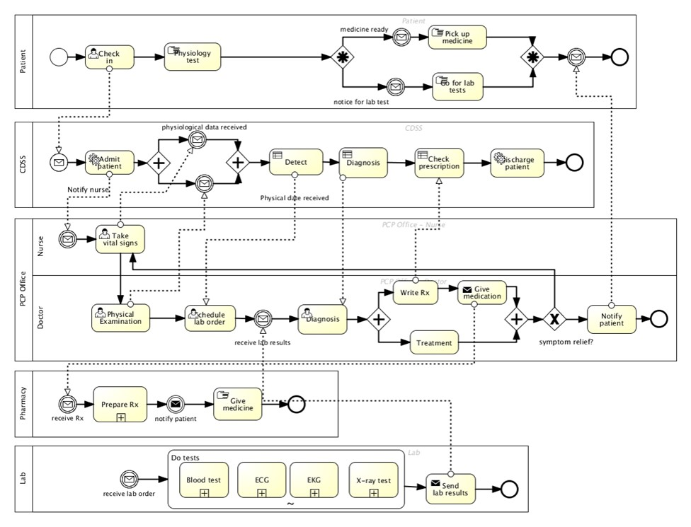
Example of a healthcare process for the treatment of an outpatient
AK: Figure 3.10

Slide 14
Allocating tasks to resources
There are two way of allocating tasks to resources, by offer and by assignment, also called pull and push respectively:
Offer
A resource is given an “offer” or an opportunity to work on a task and she can decide to accept or reject an offer within a certain time
An offer would also indicate the expected completion date of the task if it is accepted
Example- academic review process for a scholarly article submitted to a journal for possible publication works
Assignment
A system may assign a task to a certain agent based on her qualifications and availability without checking with her if she would like to do it
Example- An insurance claim assessor may receive an assignment for checking the damage to a car

Slide 15
Task Allocation Possibilities
Characteristic | Managing Staff Example
Offer v. assign | A task is offered to one or more agents, or it is assigned to a specific agent
Single v. multiple resource | One individual or several
Fixed v. flexible time | The task is done at an appointed time, or there is no specific time for it
Generic v. unique | Any surgeon from a group, or a specific surgeon (“Dr. Smith”)
Transferrrable v. non- transferrrable | The same agent must be involved throughout a task, or an agent can handoff the task to another agent.
Multitask v. single task | An anesthetist may attend to two surgeries at the same time, or he must be present in one surgery for its entire duration.
Atomic v. non-atomic | A senior nurse role may be replaced by two junior nurses, or it is not allowed.
Binding v. non-binding | The same nurse (say, Bob or Kim) must participate in all tasks (preparation, surgery, etc.) through a process instance when a nurse role is needed, or not.
AK: Table 3.1

Slide 16
An article review process
An editor contacts three reviewers, R1-R3
The inner subprocess shows that the editor waits for the three replies in a loop, and upon receiving each reply acknowledges it
If all three reviewers reply in less than 7 days, then the inner subprocess is exited
If all the replies are not received in 7 days, then the timer goes off and forces an exit of the loop, and the pending requests are canceled immediately after exit
If all three reviewers agree to review the paper then there is a subprocess S2 that receives the reviews and sends acknowledgments to the reviewers
If one or more decline to review then the editor contacts substitute reviewers (subprocess S1), sets the timer to 7 days again, and enters the inner subprocess

Slide 17
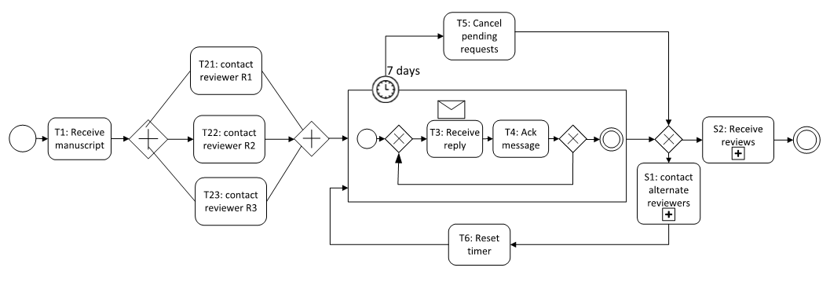
Article Review Process – Offering tasks
AK: Figure 3.11

Slide 18
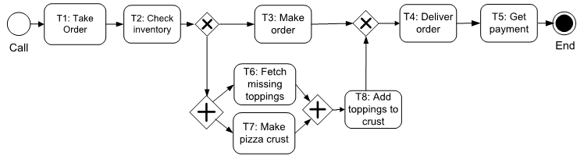
Structured Workflows
A structured (or block-structured) workflow is one in which each split control element (e.g., AND, XOR) is matched with a join control element of the same type, and such split-join pairs are also properly nested.
The number of AND-splits is equal to the number of AND-joins and the number of XOR-splits is equal to the number of XOR-joins.
AK: Figure 6.1

Slide 19
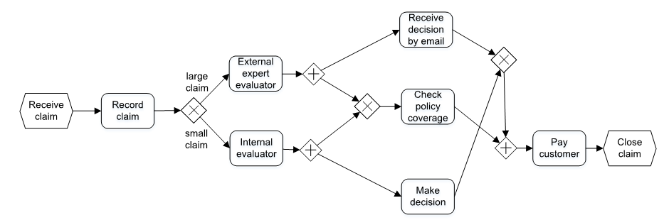
Unstructured Workflows
Unstructured workflows are different from structured ones in that the splits and joins are not matched with each other.
Crossover of a pair of edges will typically happen in an unstructured process only. It will never occur in a structured process.
AK: Figure 6.2

Slide 20
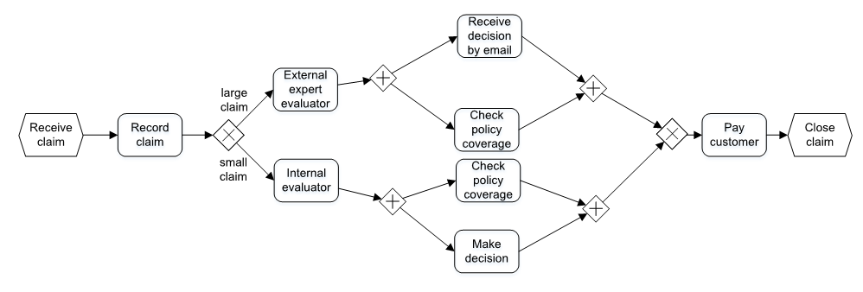
A structured representation for the unstructured process
AK: Figure 6.3

Slide 21
Sound Process Model
Definition. A sound process model is one where the following three conditions are satisfied:
Option to complete. It should always be possible to complete a running process instance that is proceeding according to the process model. This condition guarantees the absence of deadlocks and livelocks.
Proper termination. All execution paths that include a given task are valid. It should not be the case, that for some execution instance the end of the process is reached when there is still some unfinished work remaining in the instance.
No dead task. Every task should lie on at least one valid execution path from an initial start task (or event) to a final (or end) task. This means that every task contributes towards the completion of the instance.
A sound process is also called a correct or well-behaved process.

Slide 22
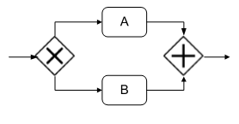
Deadlock
Only one outgoing branch is activated at the XOR node, thus both branches cannot synchronize at the AND node and further execution of the process does not proceed.
Hence, we say the process is “stuck” at the AND node and hence the process model is clearly incorrect.

Slide 23
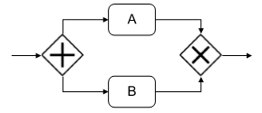
Multiple instances
An AND-split is matched with an XOR-join
At the AND-split two branches are activated for tasks A and B. However, at the XOR-join only one branch needs to be active for the join connector to be triggered.

Slide 24
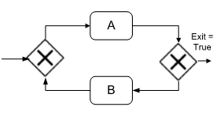
Livelock
We have a loop but there is no way to exit the loop if the Exit condition from the loop never becomes true.
This indicates a problem in the process design.
It is syntactically correct but semantically incorrect. This means that the logic of the process has to be modified so that it will always get out of the livelock after a maximum number of iterations.
A step can be added after task A such that after a certain number of iterations through the loop the exit condition will always become true.

Slide 25
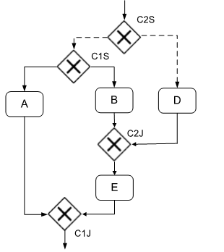
Converting an unstructured to a structured process
Dashed edges simply mean that other tasks may occur along these edges.
Two XOR split-join pairs: C1S-C1J and C2S-C2J.
C2J lies in a branch from C1S to C1J, we say that the two split-join pairs are improperly nested
C1S-C1J (and C2S-C2J) correspond with each other because there are two (or, in general, more) branches that split at C1S and meet at C1J. Such split-join pairs are called corresponding pairs.

Slide 26
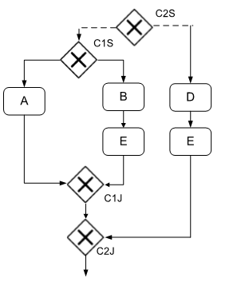
An equivalent representation for the improperly nested structure

Slide 27
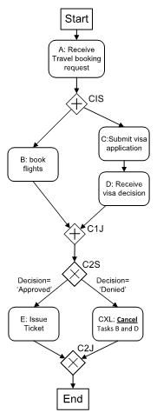
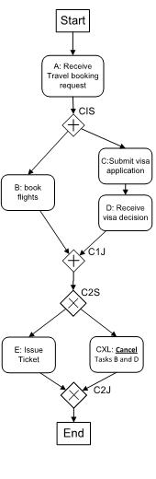
Alternative designs for the travel agent process
Here the data produced by a previous activity i.e. the decision (‘approved’ or ‘denied’) is used to constrain the control flow. This shows the importance of considering the data flow and control flow in conjunction.
This process is strictly correct if we look at the control flow alone. There is one structured AND pattern followed by a structured XOR pattern.
a) Control flow only
b) Control flow and data flow

Slide 28
Data Warehousing: Process
History of Sales & Production
Area Data
Current Data
Marketing
Sales
Transaction
Database
Data Warehouse
Production
Online Transaction Processing (OLTP)
Online Analytical Processing (OLAP)
Build Data Warehouse
Build Data Marts
Design
Map
Extract
Scrub
Transform
Load
Index
Extract
Replicate
Access
Analyze
© J. Morabito and E. A. Stohr , 2010

Slide 29
Normalized Design for TP
Colors
Color #
Color_Descr
Orders
Item #
Cust #
Date
Quan
Price-each
Items
Item #
Item_Descr
Color #
Size #
Matl #
Sizes
Size #
Size_Descr
Dates
Date
DateTyp #
Customers
Cust #
Cust_Descr
CustTyp #
City #
State #
Materials
Material #
Mat_Descr
Date-Types
DateTyp #
Date_typ_Descr
Cust_Types
Cust #
Cust_Descr
States
State #
State_Descr
What are the sales for large yellow nylon jackets to major customers in Seattle?
Cities
City #
City_Descr
9 joins - slow!

Slide 30
Star Design - Unnormalized
Fact Table
(MultiPart Key)
Products
Item #
Item_Descr
Color #
Color_Descr
Size #
Size_Descr
Matl #
Matl_Descr
Orders
Item #
Cust #
Date
Quantity
Price-each
Dates
Date
DateTyp #
Date_Typ_Descrc
Dimension Tables
(Unnormalized)
Customers
Cust #
Cust_Descr
CustTyp #
Cust_Typ_Descr
City #
City_Descr
State #
State_Descr
What are the sales for large yellow nylon jackets to major customers in Seattle?
(4 joins needed - faster)
Notes:
Composed of Fact tables and Dimension tables
A Fact table is made of two or more foreign keys that always expresses a many-to-many relationship. Always contains one or more numerical measures.
A dimension table contains descriptive textual information that are used as constraints in data warehouse queries. A dimension in effect qualifies a fact.

Slide 31
Star Schema
E.g., Sales Process in a Super Market
Time Dimension
time_key
time attributes
Product Dimension
product_key
product attributes
Sales Fact
time_key
product_key
store_key
promotion_key
dollar_sales
unit_sales
dollar_cost
Promotion Dimension
promotion_key
promotion attributes)
Store Dimension
store_key
store attributes
Note: this is a very low-level grain.
If we purchase 5 products in a single sales transaction, how many Sales Fact records will be stored?
If we purchase 2 identical products is a single transaction, how many fact records are stored?
How would this design change if we want to model a Sales Transaction?

Slide 32
Star Schema
E.g., Inventory Transaction Process
Time Dimension
time_key
time attributes
Product Dimension
product_key
product attributes
Inventory Fact
time_key
product_key
transaction_key
warehouse_key
PO_number
quantity
Warehouse Dimension
warehouse_key
warehouse attributes
Transaction Dimension
transaction_key
transaction attributes
This is a sophisticated design. It creates a fact record for every transaction that affects inventory.
Aside: a typical design has transaction as a fact table; however, in this case transaction is a
dimension that describes types of transactions that affect inventory levels. Examples of transaction
types include “place SKU in bin”, “ship SKU to customer”, “receive shipment line item”, etc.

